Slide 1
How to Determine the Density of States
Identify number of states: Length/area/volume divided by (2π/a)^n^{th} dimension
 | Length/ Area/ Volume | 1/ ”Volume” per point | Number of points
1D | k | a/2π | ak/2π
2D | π k² | (a/2π)² | a²k²/4π
3D | 4πk³/3 | (a/2π)³ | a³k³/6π²
Note: There are other ways to define this approach. That other way can involve factor of two differences, but those are fixed by doing something else another way later. Recall, this approach allows k to be negative. Some restrict it to be positive.

Slide 2
How to Determine the Density of States
Identify number of states: Length/area/volume divided by (2π/a)^n^{th} dimension
The density of levels is the dN/dk
The density of states is the density of levels times any degeneracy. Gives D(k)
D(k) dk = D(E) dE, so D(E) = D(k)
dE/dk
Check to make sure your D(E) no longer has any k’s in it.

Slide 3
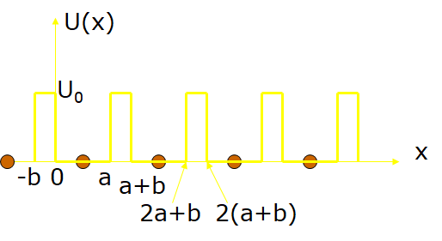
Boundary Conditions and Bloch’s Theorem
The solutions of the SE require that the wavefunction and its derivative be continuous across the potential boundaries. Thus, at the two boundaries (which are infinitely repeated):
x = 0
(1)
(2)
Use Bloch’s Theorem otherwise wavefunction not in terms of k.
Notes:
Don’t get enough info on K and kappa if don’t use bloch’s theorem.
Doesn’t matter if use Bloch’s theorem on si1 or si2 for equation 3
On equation 4, we use bloch’s theorem on both si’s
Have A, B, C and D in each equation, so use matrix form
(I changed the sign in the periodic formulas and matrix)

Slide 4
Boundary Conditions and Bloch’s Theorem
The solutions of the SE require that the wavefunction and its derivative be continuous across the potential boundaries. Thus, at the two boundaries (which are infinitely repeated):
x = 0
(1)
(2)
x = a
Now using Bloch’s theorem for R= -(a+b):
k = Bloch wavevector
Now we can write the boundary conditions at x = a:
(3)
The four simultaneous equations (1-4) can be written compactly in matrix form → Let’s start it!
(4)
Notes:
Don’t get enough info on K and kappa if don’t use bloch’s theorem.
Doesn’t matter if use Bloch’s theorem on si1 or si2 for equation 3
On equation 4, we use bloch’s theorem on both si’s
Have A, B, C and D in each equation, so use matrix form
Have them figure out first two lines of matrix.
(The lack of a negative sign is correct in periodic form. You have to solve for si2(a) and that switches the sign.)

Slide 5
Results of the Krönig-Penney Model
(1)
(2)
(3)
(4)

Slide 6
Results of the Krönig-Penney Model
Since the values of a and b are inputs to the model, and κ depends on U₀ and the energy E, we can solve this system of equations to find the energy E at any specified value of the Bloch wavevector k. What is the easiest way to do this?
Taking the determinant, setting it equal to zero and lots of algebra gives:
By reducing the barrier width b (small b), this can be simplified to:

Slide 7
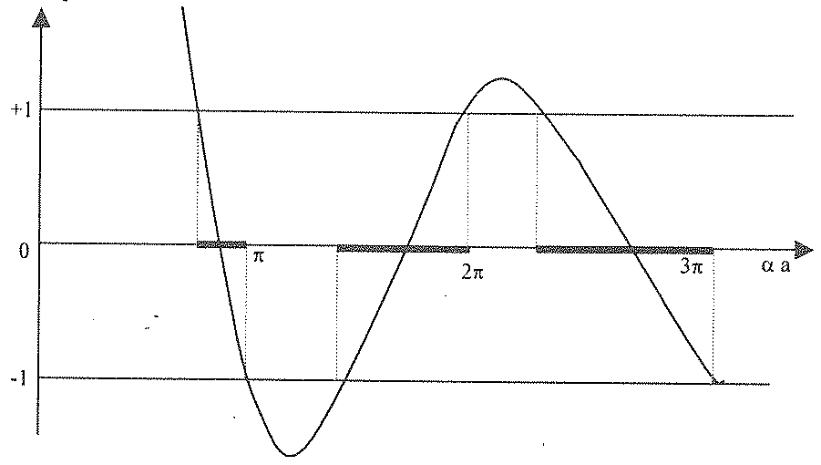
Graphical Approach
small b
Right hand side cannot exceed ±1, so values exceeding will mean that there is no wavelike solutions of the Schrodinger eq. (forbidden band gap)
Problems occur at Ka=Nπ or K=Nπ/a
Plotting left hand side
Ka
Notes:
sinh(t) = (e^{t} - e^{-t} )/2 = (e^{t} - 1)/2*e^{t} = -i sin(i t)
cosh(t) = (e^{t} + e^{-t} )/2 = (e^{t} + 1)/2*e^{t} = cos(i t)

Slide 8
Turning the last graph on its side
This equation determines the energy bands.
For values of K where the left side of the equation has a magnitude < 1, then k is real and energy bands are allowed.
BAND 2
Forbidden band gap
E(k) (a.u.)
BAND 1
Ka/π
ka/π

Slide 9
To better understand this, let’s compare to the free-electron model
  Free electron dispersion
–π/a π/a
  Let’s slowly turn on the periodic potential

Slide 10
Electron Wavefunctions in a Periodic Potential
(Another way to understand the energy gap)
Consider the following cases:
Wavefunctions are plane waves and energy bands are parabolic:
–π/a π/a
U
U₁
x
-b
0
a
a+b
2a+b
2(a+b)

Slide 11
Electron Wavefunctions in a Periodic Potential
(Another way to understand the energy gap)
Consider the following cases:
Wavefunctions are plane waves and energy bands are parabolic:
–π/a π/a
Electrons wavelengths much larger than atomic spacing a, so wavefunctions and energy bands are nearly the same as above
U
U₁
x
-b
0
a
a+b
2a+b
2(a+b)

Slide 12
Wavelength much greater than atomic spacing
Energy of wave
Similar to how radio waves pass through us without affecting

Slide 13
Wavelength much greater than atomic spacing
Energy of wave
What happens as I lower this energy?
Similar to how radio waves pass through us without affecting

Slide 14
Electron Wavefunctions in a Periodic Potential
U=barrier potential
Consider the following cases:
Wavefunctions are plane waves and energy bands are parabolic:
–π/a π/a
Electrons wavelengths much larger than a, so wavefunctions and energy bands are nearly the same as above
Electrons wavelengths approach a, so waves begin to be strongly back-scattered by the potential:

Slide 15
Electron Wavefunctions in a Periodic Potential
U=barrier potential
Consider the following cases:
Wavefunctions are plane waves and energy bands are parabolic:
–π/a π/a
Electrons wavelengths much larger than a, so wavefunctions and energy bands are nearly the same as above
Electrons wavelengths approach a, so waves begin to be strongly back-scattered by the potential:
Electrons waves are strongly back-scattered (Bragg scattering) so standing waves are formed:

Slide 16
The nearly-free-electron model (Standing Waves)
Due to the ±, there are two such standing waves possible:

Slide 17
The nearly-free-electron model (Standing Waves)
Due to the ±, there are two such standing waves possible:

Slide 18
The nearly-free-electron model (Standing Waves)
Due to the ±, there are two such standing waves possible:
These two approximate solutions to the S. E. at have very different potential energies. has its peaks at x = a, 2a, 3a, …at the positions of the atoms, where V is at its minimum (low energy wavefunction). The other solution, has its peaks at x = a/2, 3a/2, 5a/2,… at positions in between atoms, where V is at its maximum (high energy wavefunction).
Either:
Nodes at ions
Or:
Nodes midway between ions
a

Slide 19
The nearly-free-electron model
  Strictly speaking we should have looked at the probabilities
  before coming to this conclusion:
Symmetric and Antisymmetric Solutions
Different energies for electron standing waves
a

Slide 20
Summary: The nearly-free-electron model
  BAND GAPS APPEAR AT EACH BRILLOUIN ZONE EDGE
The periodic potential V(x) splits the free-electron E(k) into “energy bands” separated by gaps at each BZ boundary.
  In between the two energies there are no allowed energies; i.e., wavelike solutions of the Schrodinger equation do not exist.
  Forbidden energy bands form called band gaps.
E₋
E_{g}
E₊
-2π/a –π/a π/a 2π/a

Slide 21
Approximating the Band Gap
  BAND GAPS APPEAR AT EACH BRILLOUIN ZONE EDGE
E₋
E_{g}
E₊
-2π/a –π/a π/a 2π/a

Slide 22
Approximating the Band Gap
  BAND GAPS APPEAR AT EACH BRILLOUIN ZONE EDGE
E₋
E_{g}
E₊
-2π/a –π/a π/a 2π/a

Slide 23
Approximating the Band Gap
  BAND GAPS APPEAR AT EACH BRILLOUIN ZONE EDGE
E₋
E_{g}
E₊
-2π/a –π/a π/a 2π/a

Slide 24
Approximating the Band Gap
  BAND GAPS APPEAR AT EACH BRILLOUIN ZONE EDGE
E₋
E_{g}
E₊
-2π/a –π/a π/a 2π/a
  For square potential: V(x) =V_{o} for specific values of x (changes integration limits)

Slide 25
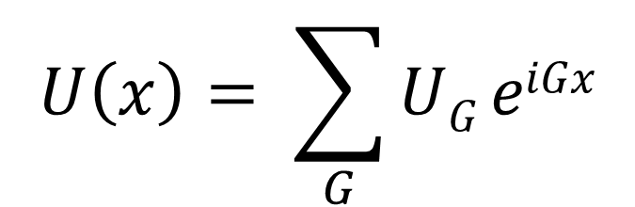
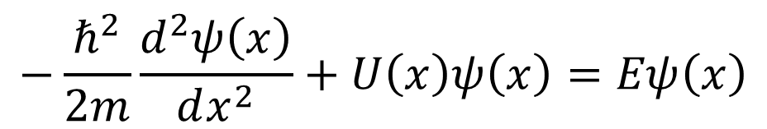

Just need Fourier components of U
$$U\left(x\right)= \sum_{G}{UG eiGx}$$
Values of U_{G} decrease rapidly with increasing G.
By pulling into Sch. Equ, it can be shown that the wavefunction may be expressed as a Fourier series summed over all values of the wavevector
$$−\frac{ℏ^{2}}{2m}\frac{d^{2}ψ\left(x\right)}{dx^{2}}+U\left(x\right)ψ\left(x\right)=Eψ\left(x\right)$$
$$Ψ\left(x\right)=∑k C\left(k\right) eikx$$
Notes:
C(k) sometimes written as Csubscriptk

Slide 26
Two Common Approaches
Do Non-Physicists Think Quantum Wells are Easy?
A Physicist Thinks Quantum Wells are Easy (Kroniq-Penney Model or Nearly Free Electron Approx.)
  “Chemist’s View” - Start with atomic energy levels & build up the periodic solid by decreasing distance between atoms (tightbinding or linear combination of atomic orbitals
U(x)
x
d

Slide 27
Approach 2: Tightbinding or Linear Combination of Atomic Orbitals (LCAO)
Assume the atomic orbitals ~ unchanged

Slide 28
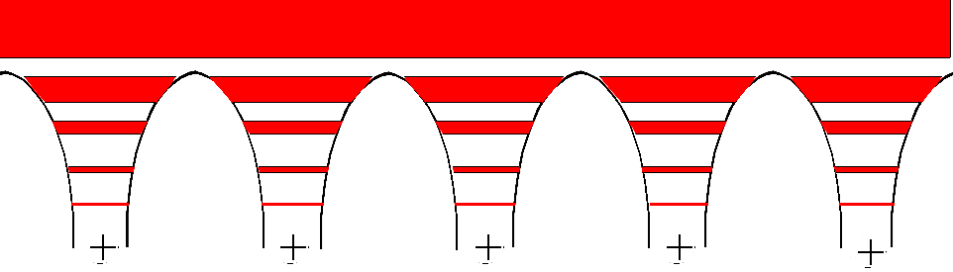
Approach 2: Tightbinding or Linear Combination of Atomic Orbitals (LCAO)
Assume the atomic orbitals ~ unchanged
bare atoms
solid
Atomic energy levels merge to form molecular levels & merge to form bands

Slide 29
Compare to hydrogen
When atoms are covalently bonded electrons are shared by atoms

Slide 30
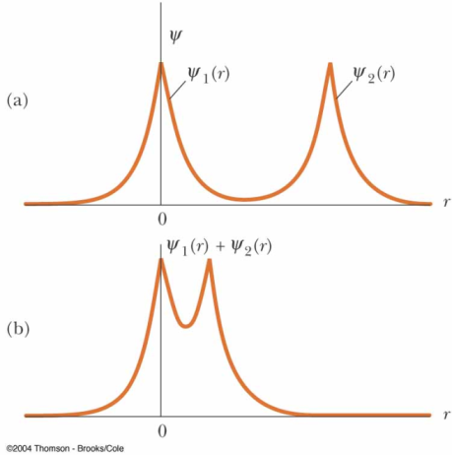
Compare to hydrogen
When atoms are covalently bonded electrons are shared by atoms
Example: the ground state of the hydrogen atoms forming a molecule
  If atoms far apart, little overlap

Slide 31
Compare to hydrogen
When atoms are covalently bonded electrons are shared by atoms
Example: the ground state of the hydrogen atoms forming a molecule
  If atoms far apart, little overlap
  If atoms are brought together the wavefunctions overlap and form the compound wavefunction, ψ₁(r)+ψ₂(r), increasing the probability for electrons to exist between atoms

Slide 32
Compare to hydrogen
When atoms are covalently bonded electrons are shared by atoms
Example: the ground state of the hydrogen atoms forming a molecule
  If atoms far apart, little overlap
  If atoms are brought together the wavefunctions overlap and form the compound wavefunction, ψ₁(r)+ψ₂(r), increasing the probability for electrons to exist between atoms

Slide 33
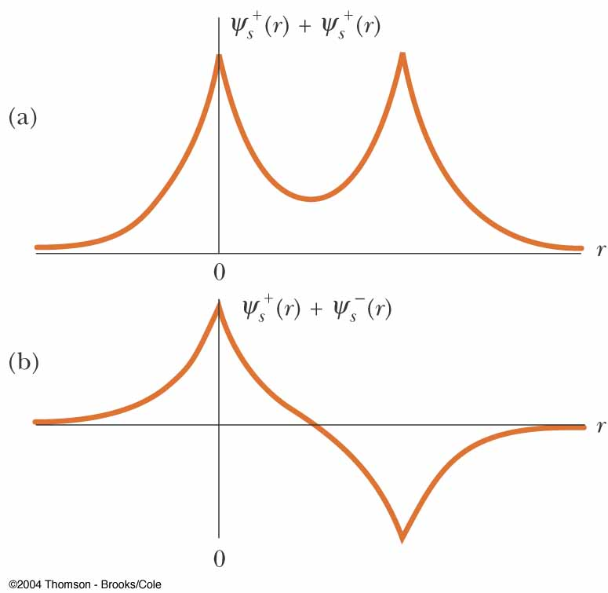
Compare to hydrogen
When atoms are covalently bonded electrons are shared by atoms
Example: the ground state of the hydrogen atoms forming a molecule
  If atoms far apart, little overlap
  If atoms are brought together the wavefunctions overlap and form the compound wavefunction, ψ₁(r)+ψ₂(r), increasing the probability for electrons to exist between atoms
These two possible combinations represent 2 possible states of two atoms system with different energies

Slide 34
LCAO: Electron in Hydrogen Atom
(in Ground State)

Slide 35
LCAO: Electron in Hydrogen Atom
(in Ground State)
Second hydrogen atom

Slide 36
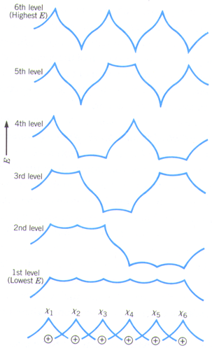
LCAO: Electron in Hydrogen Atom
(in Ground State)
Second hydrogen atom
Do you see a pattern?
Number of Nodes?

Slide 37
LCAO: Electron in Hydrogen Atom
(in Ground State)
5
4
Second hydrogen atom
3
2
Do you see a pattern?
1
0
Number of Nodes?

Slide 38
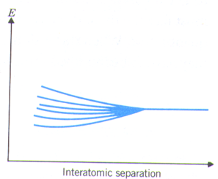
LCAO: Electron in Hydrogen Atom
(in Ground State)
5
4
Second hydrogen atom
3
2
Do you see a pattern?
1
0
Number of Nodes?

Slide 39
If there are N atoms in the chain there will be N energy levels and N electronic states (molecular orbits). The wavefunction for each electronic state is:
Ψ_{k} = Σ e^{ikna}χ_{n}=
a is the lattice constant,
n identifies the individual atoms within the chain,
χ_{n} represents the atomic orbitals of each individual atom
χ₀
χ₁
χ₂
χ₃
χ₄
k=π/a
n
k=π/2a
k=0
a

Slide 40
If there are N atoms in the chain there will be N energy levels and N electronic states (molecular orbits). The wavefunction for each electronic state is:
Ψ_{k} = Σ e^{ikna}χ_{n}=
e⁰χ₀+e^{ika}χ₁+e^{2ika}χ₂+e^{3ika}χ₃+e^{4ika}χ₄
a is the lattice constant,
n identifies the individual atoms within the chain,
χ_{n} represents the atomic orbitals of each individual atom
χ₀
χ₁
χ₂
χ₃
χ₄
k=π/a
n
k=π/2a
k=0
a

Slide 41
If there are N atoms in the chain there will be N energy levels and N electronic states (molecular orbits). The wavefunction for each electronic state is:
Ψ_{k} = Σ e^{ikna}χ_{n}=
e⁰χ₀+e^{ika}χ₁+e^{2ika}χ₂+e^{3ika}χ₃+e^{4ika}χ₄
a is the lattice constant,
n identifies the individual atoms within the chain,
χ_{n} represents the atomic orbitals of each individual atom
k is a quantum # that identifies the wavefunction and tells us the phase of the orbitals.
χ₀
χ₁
χ₂
χ₃
χ₄
k=π/a
n
k=π/2a
k=0
a
The larger the absolute value of k, the more nodes one has

Slide 42
Group: For 0, 2 and 4 nodes, determine wavefunctions (plug in n and k)
If there are N atoms in the chain there will be N energy levels and N electronic states (molecular orbits). The wavefunction for each electronic state is:
Ψ_{k} = Σ e^{ikna}χ_{n}=
e⁰χ₀+e^{ika}χ₁+e^{2ika}χ₂+e^{3ika}χ₃+e^{4ika}χ₄
a is the lattice constant,
n identifies the individual atoms within the chain,
χ_{n} represents the atomic orbitals of each individual atom
k is a quantum # that identifies the wavefunction and tells us the phase of the orbitals.
χ₀
χ₁
χ₂
χ₃
χ₄
k=π/a
n
k=π/2a
k=0
a
The larger the absolute value of k, the more nodes one has

Slide 43
Infinite 1D Chain of H atoms
χ₀
χ₁
χ₂
χ₃
χ₄
k=π/a
k=π/2a
k = 0
Ψ₀ = χ₀+χ₁ +χ₂ +χ₃ +χ₄ +…
k=0
a

Slide 44
Infinite 1D Chain of H atoms
k = π/a
Ψ_{π/a} = χ₀+(exp{iπ})χ₁ +(exp{i2π})χ₂ +(exp{i3π})χ₃+(exp{i4π})χ₄+…
χ₀
χ₁
χ₂
χ₃
χ₄
k=π/a
k=π/2a
k = 0
Ψ₀ = χ₀+χ₁ +χ₂ +χ₃ +χ₄ +…
k=0
a

Slide 45
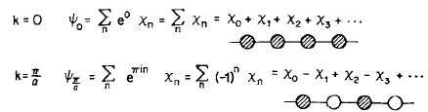
Infinite 1D Chain of H atoms
k = π/a
Ψ_{π/a} = χ₀+(exp{iπ})χ₁ +(exp{i2π})χ₂ +(exp{i3π})χ₃+(exp{i4π})χ₄+…
Ψ_{π/a} = χ₀ - χ₁ + χ₂ - χ₃ + χ₄ +…
χ₀
χ₁
χ₂
χ₃
χ₄
k=π/a
k=π/2a
k = 0
Ψ₀ = χ₀+χ₁ +χ₂ +χ₃ +χ₄ +…
k=0
a
k=0 → orbital phase does not change when we translate by a
k=π/a → orbital phase reverses when we translate by a

Slide 46
Infinite 1D Chain of H atoms
k = π/a
Ψ_{π/a} = χ₀+(exp{iπ})χ₁ +(exp{i2π})χ₂ +(exp{i3π})χ₃+(exp{i4π})χ₄+…
Ψ_{π/a} = χ₀ - χ₁ + χ₂ - χ₃ + χ₄ +…
χ₀
χ₁
χ₂
χ₃
χ₄
k=π/a
k = π/2a
Ψ_{π/2a} = χ₀+(exp{iπ/2})χ₁ +(exp{iπ})χ₂ +(exp{i3π/2})χ₃+(exp{i2π})χ₄+…
Ψ_{π/2a} = χ₀ + i χ₁ - χ₂ - i χ₃ + χ₄ +…
k=π/2a
k = 0
Ψ₀ = χ₀+χ₁ +χ₂ +χ₃ +χ₄ +…
k=0
a
k=0 → orbital phase does not change when we translate by a
k=π/a → orbital phase reverses when we translate by a

Slide 47
Infinite 1D Chain of H atoms
What would happen if consider k> π/a?
If not obvious, try k=2 π/a. What is the wavefunction?
Ψ_{k} = Σ e^{ikna}χ_{n}
Notes:
They just repeat. You can see the solution for k=2pi/a is the same as for k=0. The reason it is not like pi/a is because the way the bands fold back over the Brillouin zone

Slide 48
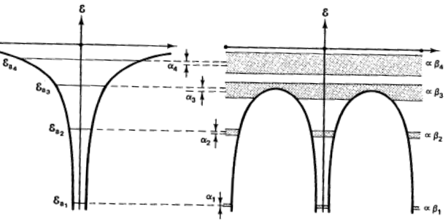
Energy bands of a crystal
Tight binding model results in the same form of energy bands as in the nearly free electron model
Note the higher energy states are nearly free
This method gives good core electron bands!
The high bands are not as good because electrons act free!

Slide 49
Effect of Orbital Overlap band width or dispersion=the difference in energy between the highest and lowest energy levels in the band
Band width

Slide 50
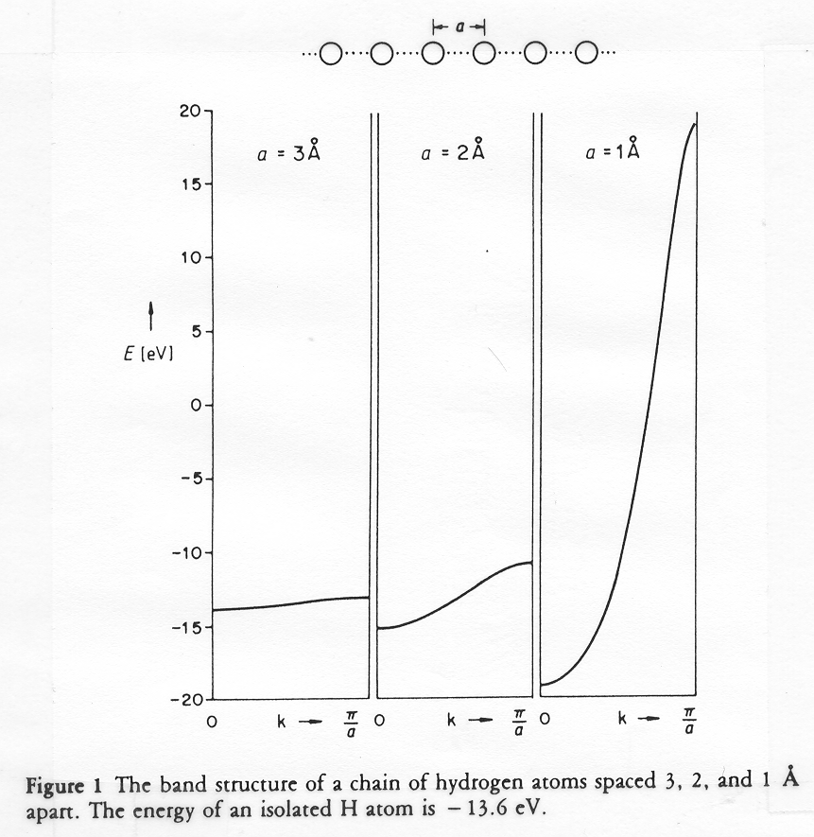
Effect of Orbital Overlap band width or dispersion=the difference in energy between the highest and lowest energy levels in the band
If we reduce the lattice parameter a (bring closer together) it has the following effects:

Slide 51
Effect of Orbital Overlap band width or dispersion=the difference in energy between the highest and lowest energy levels in the band
If we reduce the lattice parameter a (bring closer together) it has the following effects:
The spatial overlap of the orbitals increases

Slide 52
Effect of Orbital Overlap band width or dispersion=the difference in energy between the highest and lowest energy levels in the band
If we reduce the lattice parameter a (bring closer together) it has the following effects:
The spatial overlap of the orbitals increases
The band becomes more bonding (energy reduces) at k=0

Slide 53
Effect of Orbital Overlap band width or dispersion=the difference in energy between the highest and lowest energy levels in the band
If we reduce the lattice parameter a (bring closer together) it has the following effects:
The spatial overlap of the orbitals increases
The band becomes more bonding (energy reduces) at k=0
The band becomes more antibonding (energy up) k=π/a.

Slide 54
Effect of Orbital Overlap band width or dispersion=the difference in energy between the highest and lowest energy levels in the band
If we reduce the lattice parameter a (bring closer together) it has the following effects:
The spatial overlap of the orbitals increases
The band becomes more bonding (energy reduces) at k=0
The band becomes more antibonding (energy up) k=π/a.
The increased antibonding is larger than the increased bonding.

Slide 55
Effect of Orbital Overlap band width or dispersion=the difference in energy between the highest and lowest energy levels in the band
If we reduce the lattice parameter a (bring closer together) it has the following effects:
The spatial overlap of the orbitals increases
The band becomes more bonding (energy reduces) at k=0
The band becomes more antibonding (energy up) k=π/a.
The increased antibonding is larger than the increased bonding.
The bandwidth increases.

Slide 56
Effect of Orbital Overlap band width or dispersion=the difference in energy between the highest and lowest energy levels in the band
If we reduce the lattice parameter a (bring closer together) it has the following effects:
The spatial overlap of the orbitals increases
The band becomes more bonding (energy reduces) at k=0
The band becomes more antibonding (energy up) k=π/a.
The increased antibonding is larger than the increased bonding.
The bandwidth increases.
The electron mobility increases.
Wide bands → Good orbital overlap → High carrier mobility

Slide 57
Main points in the proof of Bloch’s Theorem in 1-D
Notes:
Plug in r+R for r in the top equation. Then use the second equation to set u’s equal.

Slide 58
Main points in the proof of Bloch’s Theorem in 1-D
1. First notice that Bloch’s theorem implies (3D version):
Notes:
Plug in r+R for r in the top equation. Then use the second equation to set u’s equal.

Slide 59
Main points in the proof of Bloch’s Theorem in 1-D
1. First notice that Bloch’s theorem implies (3D version):
Notes:
Plug in r+R for r in the top equation. Then use the second equation to set u’s equal.

Slide 60
Main points in the proof of Bloch’s Theorem in 1-D
1. First notice that Bloch’s theorem implies (3D version):
Notes:
Plug in r+R for r in the top equation. Then use the second equation to set u’s equal.

Slide 61
Main points in the proof of Bloch’s Theorem in 1-D
1. First notice that Bloch’s theorem implies (3D version):
Or just:
Can show that this formally implies Bloch’s theorem, so if we can prove it we will have proven Bloch’s theorem.
Notes:
Plug in r+R for r in the top equation. Then use the second equation to set u’s equal.

Slide 62
Main points in the proof of Bloch’s Theorem in 1-D
1. First notice that Bloch’s theorem implies (3D version):
Or just:
Can show that this formally implies Bloch’s theorem, so if we can prove it we will have proven Bloch’s theorem.
2. To prove the statement shown above in 1-D:
Consider N identical lattice points around a circular ring, each separated by a distance a. Our task is to prove:
1
2
N
3
Notes:
Plug in r+R for r in the top equation. Then use the second equation to set u’s equal.

Slide 63
Main points in the proof of Bloch’s Theorem in 1-D
1. First notice that Bloch’s theorem implies (3D version):
Or just:
Can show that this formally implies Bloch’s theorem, so if we can prove it we will have proven Bloch’s theorem.
2. To prove the statement shown above in 1-D:
Consider N identical lattice points around a circular ring, each separated by a distance a. Our task is to prove:
1
2
N
3
Notes:
Plug in r+R for r in the top equation. Then use the second equation to set u’s equal.

Slide 64
Main points in the proof of Bloch’s Theorem in 1-D
1. First notice that Bloch’s theorem implies (3D version):
Or just:
Can show that this formally implies Bloch’s theorem, so if we can prove it we will have proven Bloch’s theorem.
2. To prove the statement shown above in 1-D:
Consider N identical lattice points around a circular ring, each separated by a distance a. Our task is to prove:
1
2
N
Built into the ring model is the periodic boundary condition:
3
Notes:
Plug in r+R for r in the top equation. Then use the second equation to set u’s equal.

Slide 65
Proof of Bloch’s Theorem in 1-D: Conclusion
The symmetry of the ring implies that we can find a solution to the wave equation (QM reason too):
If we apply this translation N times we will return to the initial atom position:
1
2
N
3
Notes:
There is a quantum mechanical reason is due to commuting operators.
For example, remember when k=0, they were all the same phase.
T_{R} is a translation operator that shifts the position by vector R
Since the Hamiltonian/energy is periodic, it doesn’t matter if we translate the wavefunction before or after the Hamiltonian. T and H commute

Slide 66
Proof of Bloch’s Theorem in 1-D: Conclusion
The symmetry of the ring implies that we can find a solution to the wave equation (QM reason too):
If we apply this translation N times we will return to the initial atom position:
This requires
And has the most general solution:
1
2
N
3
Notes:
There is a quantum mechanical reason is due to commuting operators.
For example, remember when k=0, they were all the same phase.
T_{R} is a translation operator that shifts the position by vector R
Since the Hamiltonian/energy is periodic, it doesn’t matter if we translate the wavefunction before or after the Hamiltonian. T and H commute

Slide 67
Proof of Bloch’s Theorem in 1-D: Conclusion
The symmetry of the ring implies that we can find a solution to the wave equation (QM reason too):
If we apply this translation N times we will return to the initial atom position:
This requires
And has the most general solution:
1
2
N
Or:
3
Where we define the Bloch wavevector:
Notes:
There is a quantum mechanical reason is due to commuting operators.
For example, remember when k=0, they were all the same phase.
T_{R} is a translation operator that shifts the position by vector R
Since the Hamiltonian/energy is periodic, it doesn’t matter if we translate the wavefunction before or after the Hamiltonian. T and H commute

Slide 68
Proof of Bloch’s Theorem in 1-D: Conclusion
The symmetry of the ring implies that we can find a solution to the wave equation (QM reason too):
If we apply this translation N times we will return to the initial atom position:
This requires
And has the most general solution:
1
2
N
Or:
3
Where we define the Bloch wavevector:
Now that we know C we can rewrite
Notes:
There is a quantum mechanical reason is due to commuting operators.
For example, remember when k=0, they were all the same phase.
T_{R} is a translation operator that shifts the position by vector R
Since the Hamiltonian/energy is periodic, it doesn’t matter if we translate the wavefunction before or after the Hamiltonian. T and H commute

Slide 69
Proof of Bloch’s Theorem in 1-D: Conclusion
The symmetry of the ring implies that we can find a solution to the wave equation (QM reason too):
If we apply this translation N times we will return to the initial atom position:
This requires
And has the most general solution:
1
2
N
Or:
3
Compare to past discussion of how many states in a band
Where we define the Bloch wavevector:
Now that we know C we can rewrite
Notes:
There is a quantum mechanical reason is due to commuting operators.
For example, remember when k=0, they were all the same phase.
T_{R} is a translation operator that shifts the position by vector R
Since the Hamiltonian/energy is periodic, it doesn’t matter if we translate the wavefunction before or after the Hamiltonian. T and H commute

